Slide 1
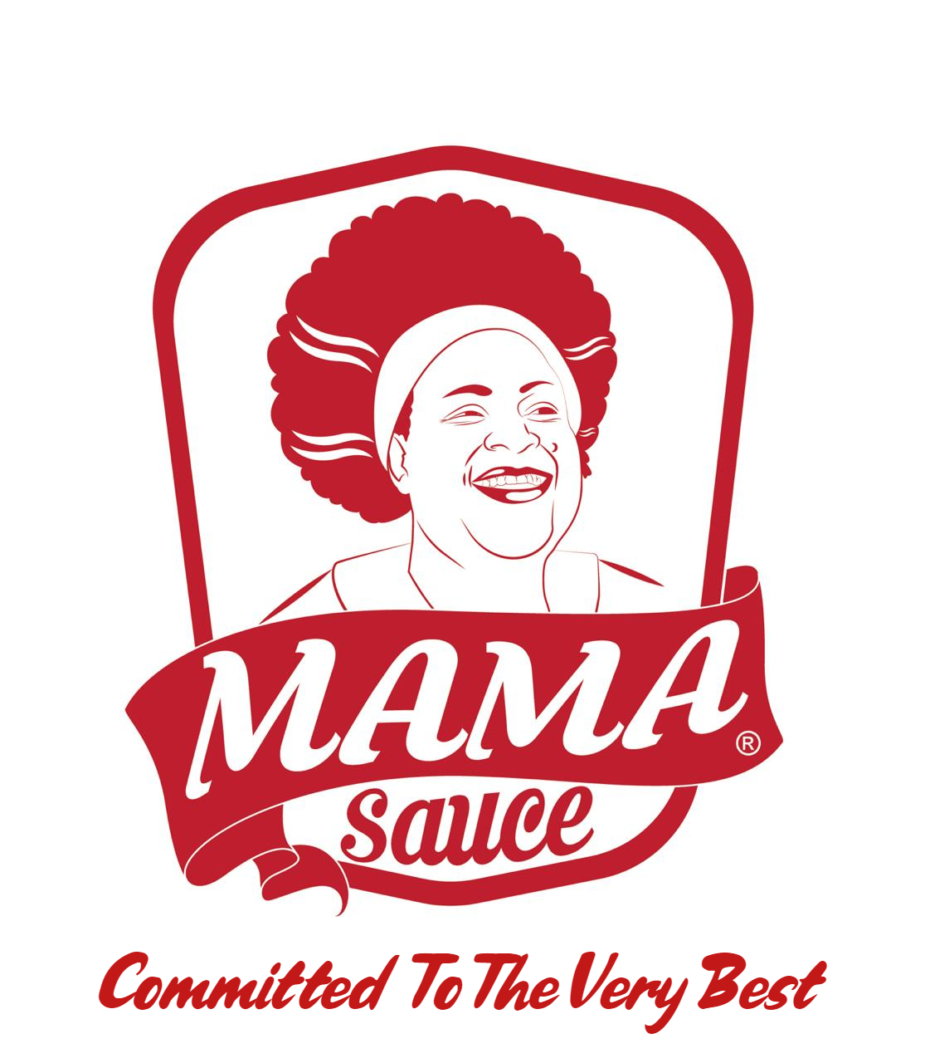


Slide 2
WELCOME TO MAMA SAUCE FACTORY For Food Industries

Slide 3
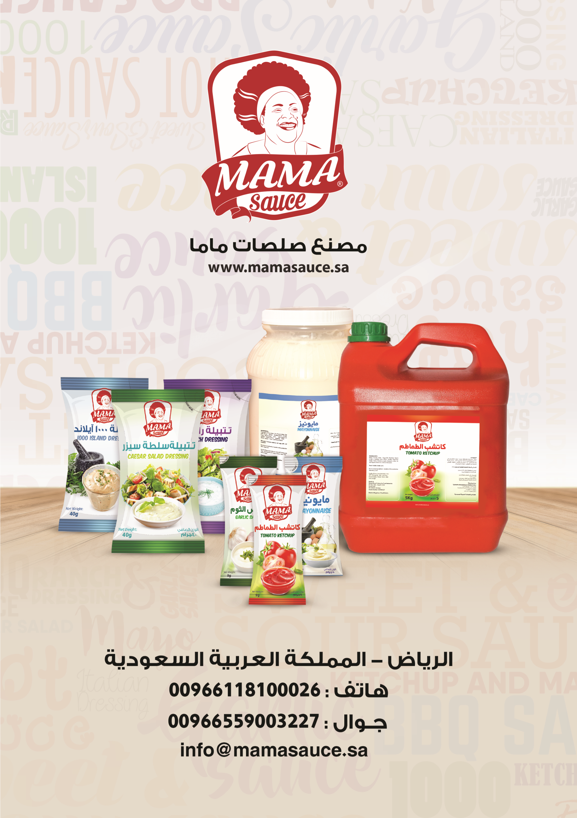

Slide 4
About Us
Mama Sauce Factory For Food Industries, It is family-owned company with more than 100 hard-working staff members.
Operated manufacturing facility based in Riyadh.
MSF extends on an area up to 13000sqm.
Equipped with high technology machines and meets the highest hygienic environmental laboratories that enable us to test, analyze, match and create most complex sauces blends.

Slide 5
Our Vision
At MAMA SAUCE, one clear vision has been our guide to provide products with the highest international standards by developing expertise and utilizing state of the art technology.
We will be leading producer of competitively priced food items in the market.

Slide 6
Our Mission
Our company is devoted to deliver our customers with prime quality and distinctive taste in sauces that we produce. In addiction to this we aim to keep the price fair for the benefit of our partners.

Slide 7
EXPERTISE
Over the recent years, MAMA SAUCE has become one of the competitive and experienced supplier of sauces in the QSR and Food Service markets all over the GCC.
Our product portfolio includes Ketchup, Mayonnaise, Salad Dressings, Specialty Sauces.
In addition to our standard services, we have participated in food exhibition and also developed more than 150 signature products under NDA(None disclosure agreement) for wide array of regional food service operators across verity of channels.
QSR (Quick Service Restaurant)
CDR ( Casual Dinning Restaurant)
FDR ( Fine Dinning Restaurant)
HORECA MARKET ( Hotel, Restaurants, Catering.
FOOD EXHIBITION

Slide 8
The MAMA Way Our Shared Goal: To make it easier and more valuable for our customer to do business with us.
Who We are: We are one of the leading sauces manufactures in regards to sauce industry and customers preferences.
What We Do: We Lead to better, better Food, in a better way, for a better future;
understanding trends, distilling them into insight and converting those insight into great-tasting, more nutritious products for our customers.
How We Do It: By working as one high-performing regionally connected, Mama Team; partnering across all internal functions with a consumer and customer- focused mindset.
Where We Are Going
Market Place Work Place
Industry Reference First Choice
And Customer Preference For the Best Talent
We Own IT, Grow Together, WIN
Why We Matter: Inspire Food . Nourish Life

Slide 9
MAMA SAUCE CERTIFICATES

Slide 10
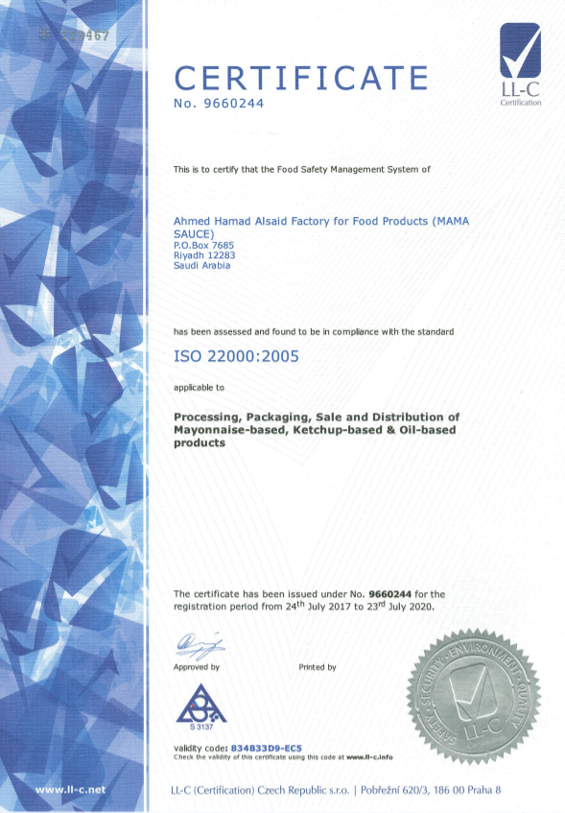

ISO 22000:2005

Slide 11
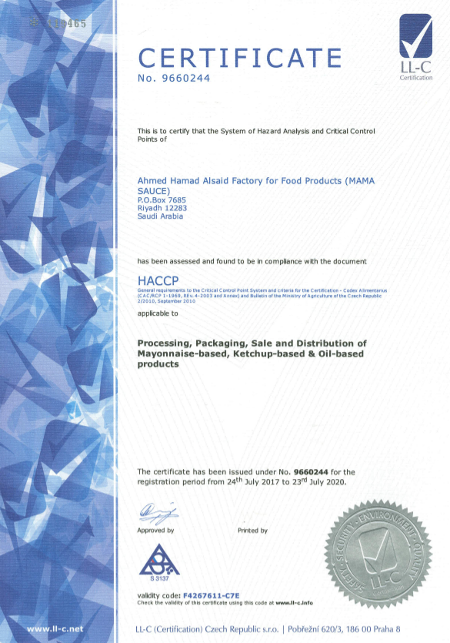

HACCP

Slide 12
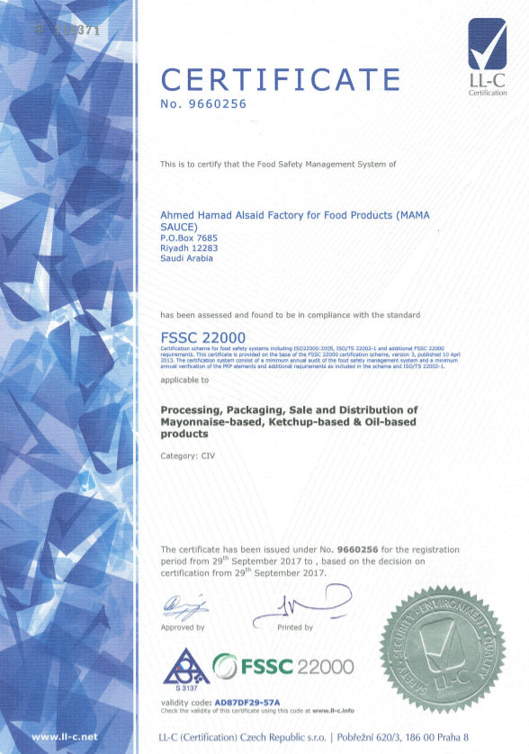

FSSC 22000

Slide 13











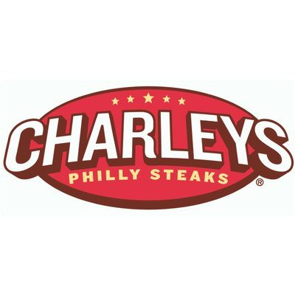


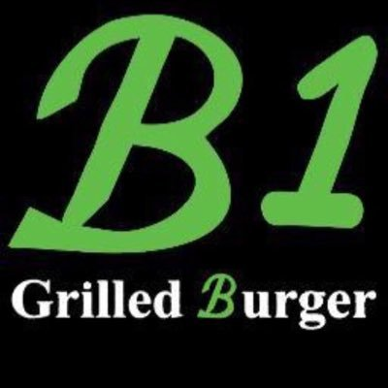







شــــركــــاء الــنــــجــــاح
SUCCESS PARTNERS

Slide 14
MAMA SAUCE PRODUCTS

Slide 15
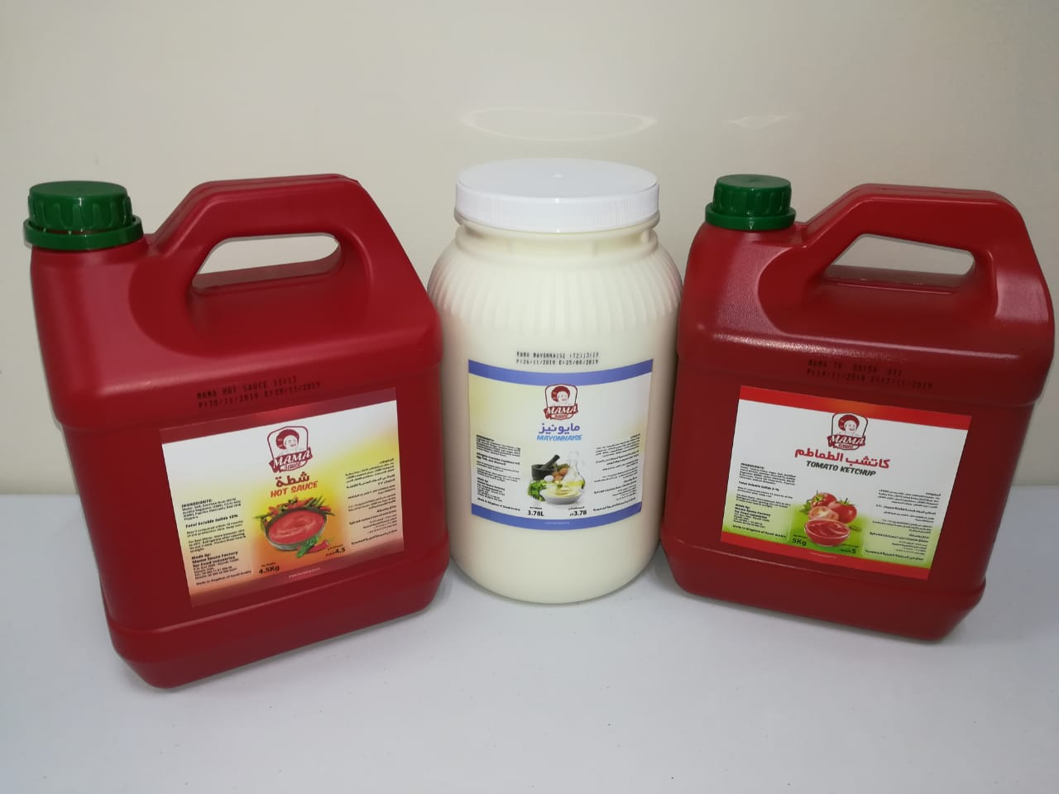
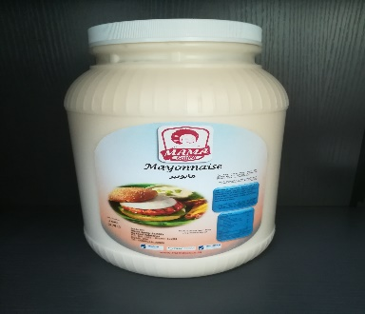
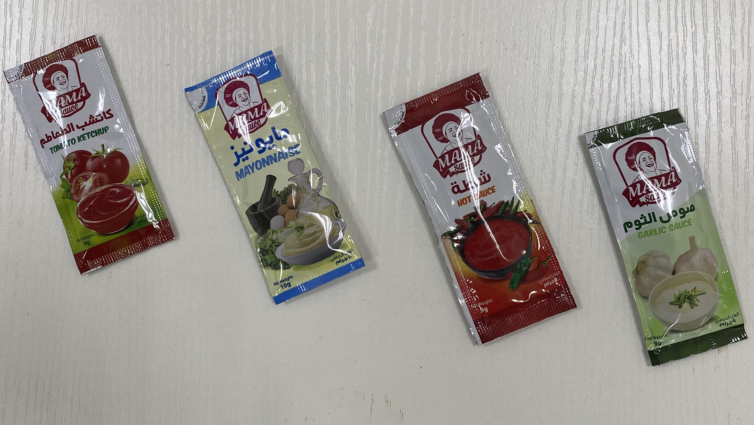
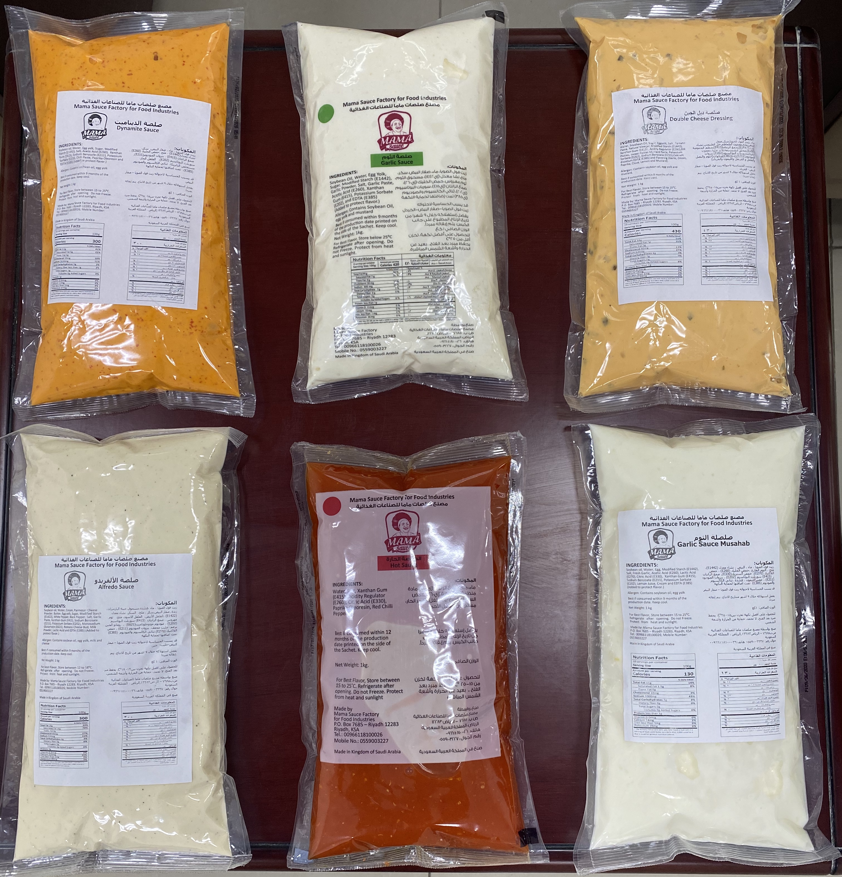

Slide 16
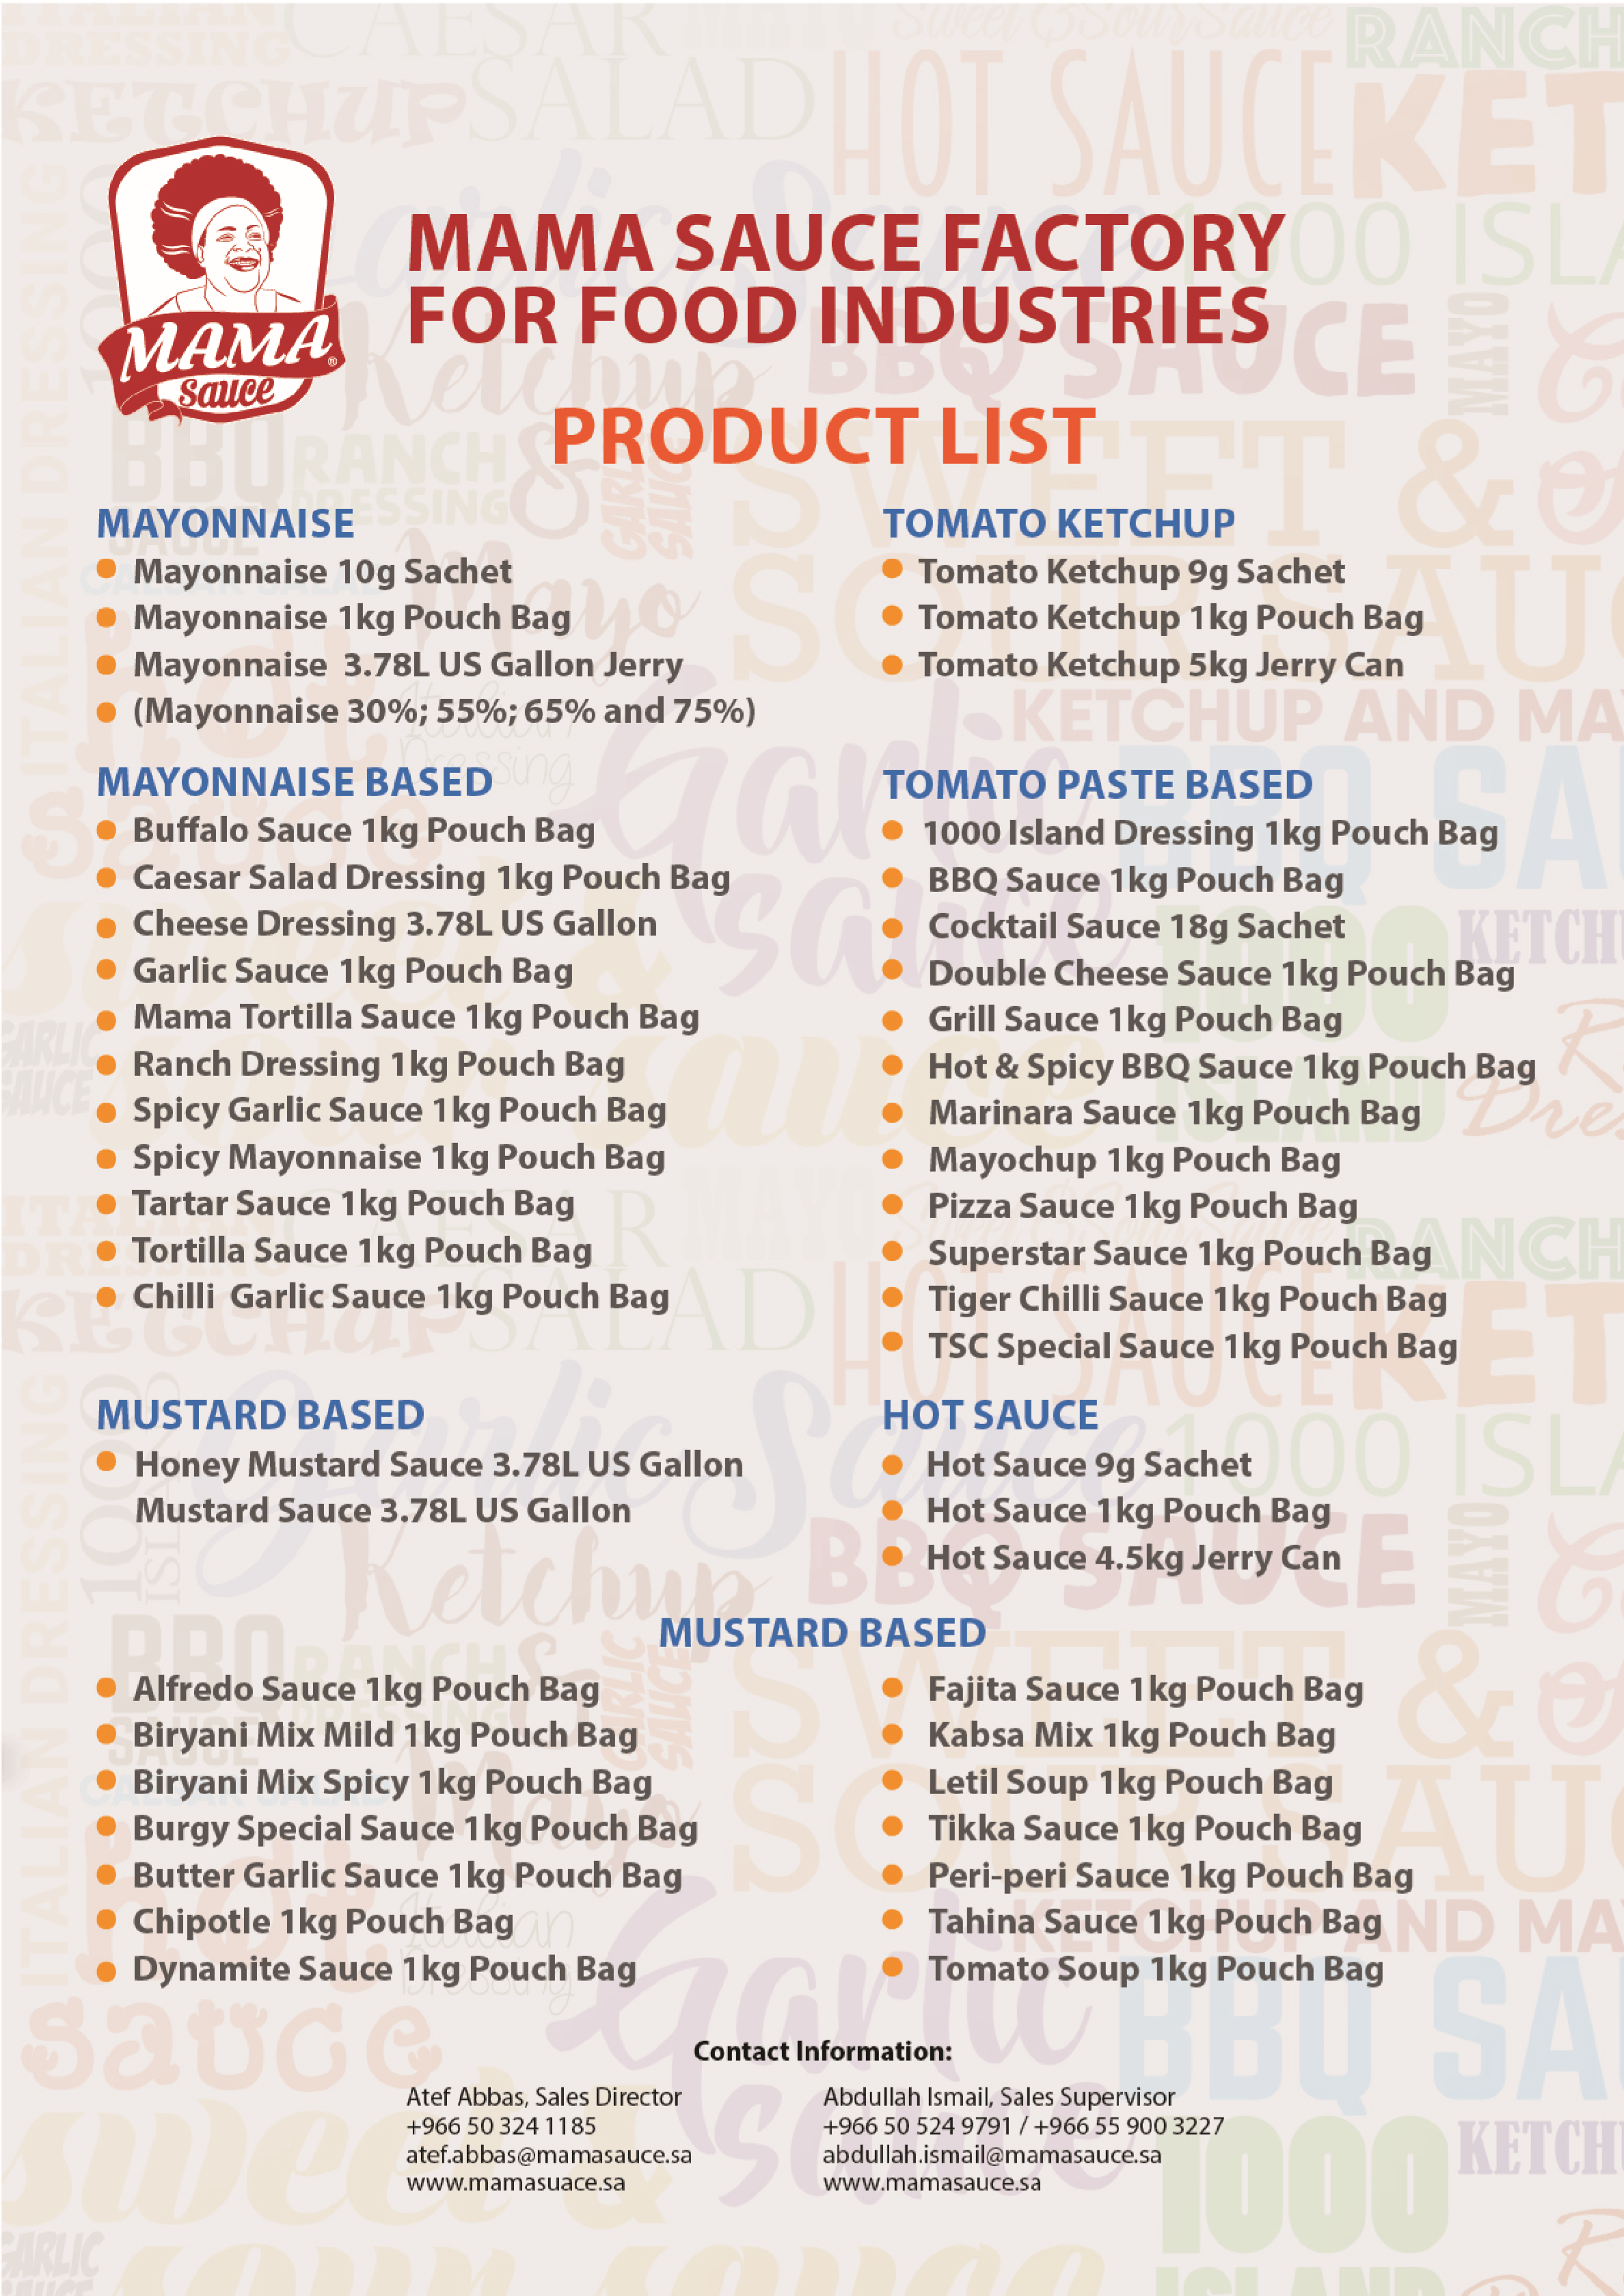

Slide 17
PRIVET LABEL
Mama Sauce Factory, works on end to end privet label projects for clients by consuming recipes and packaging as required.
We also work on co-packing projects with multinational companies.

Slide 18
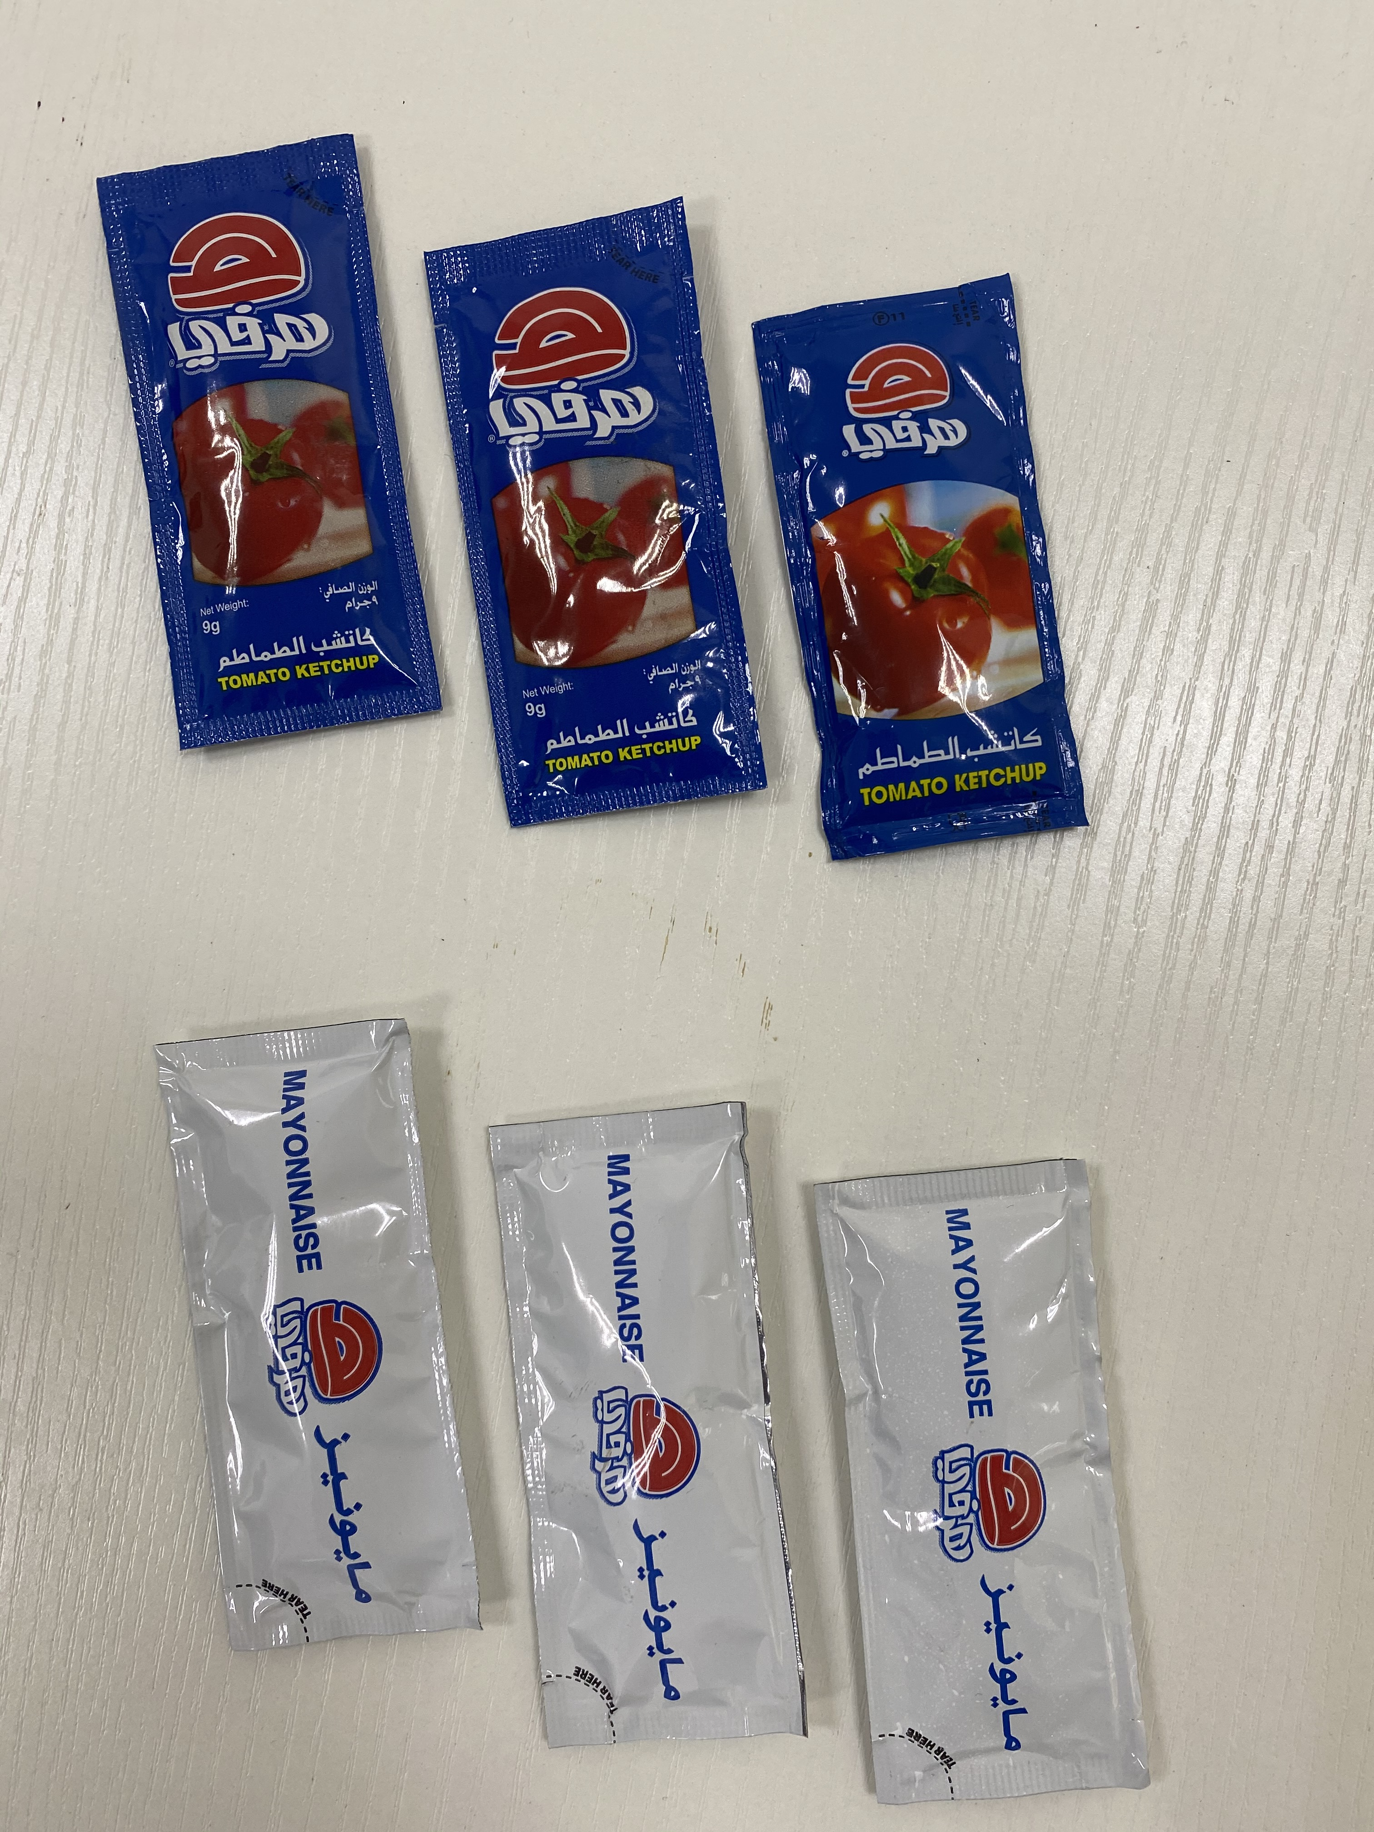
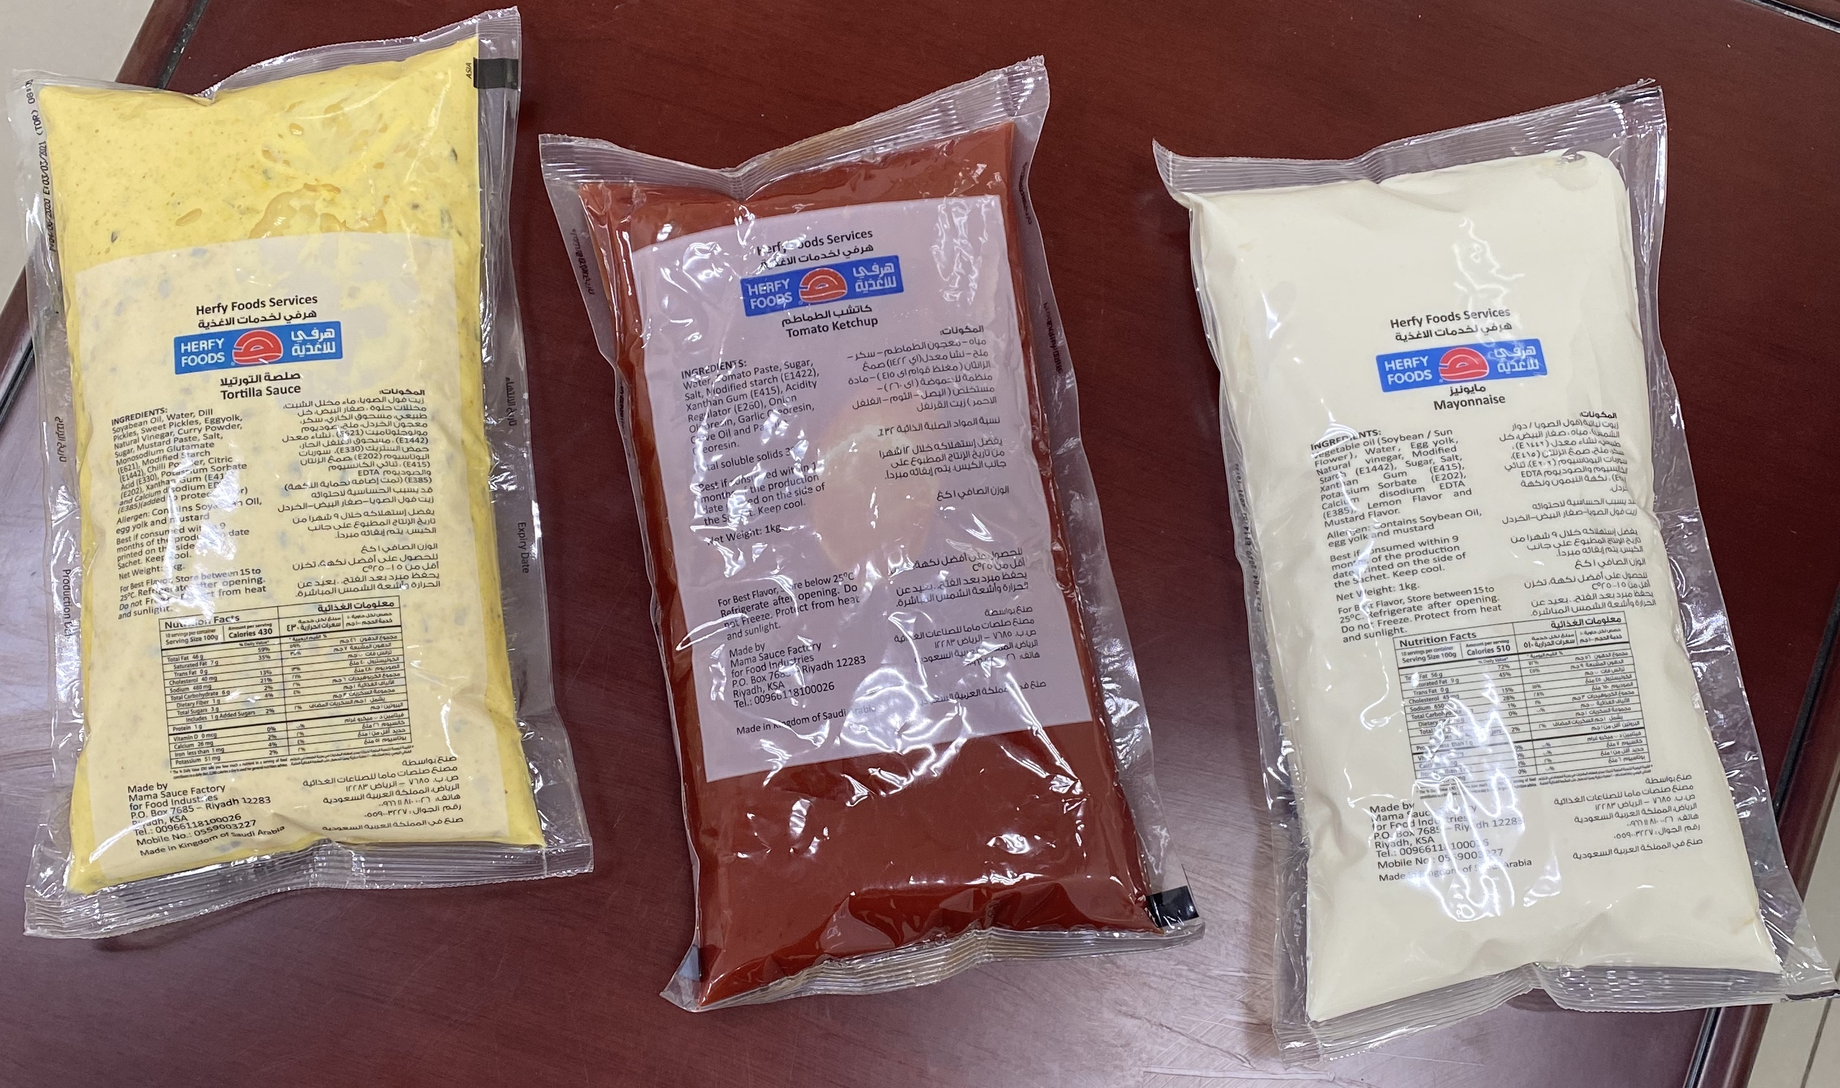
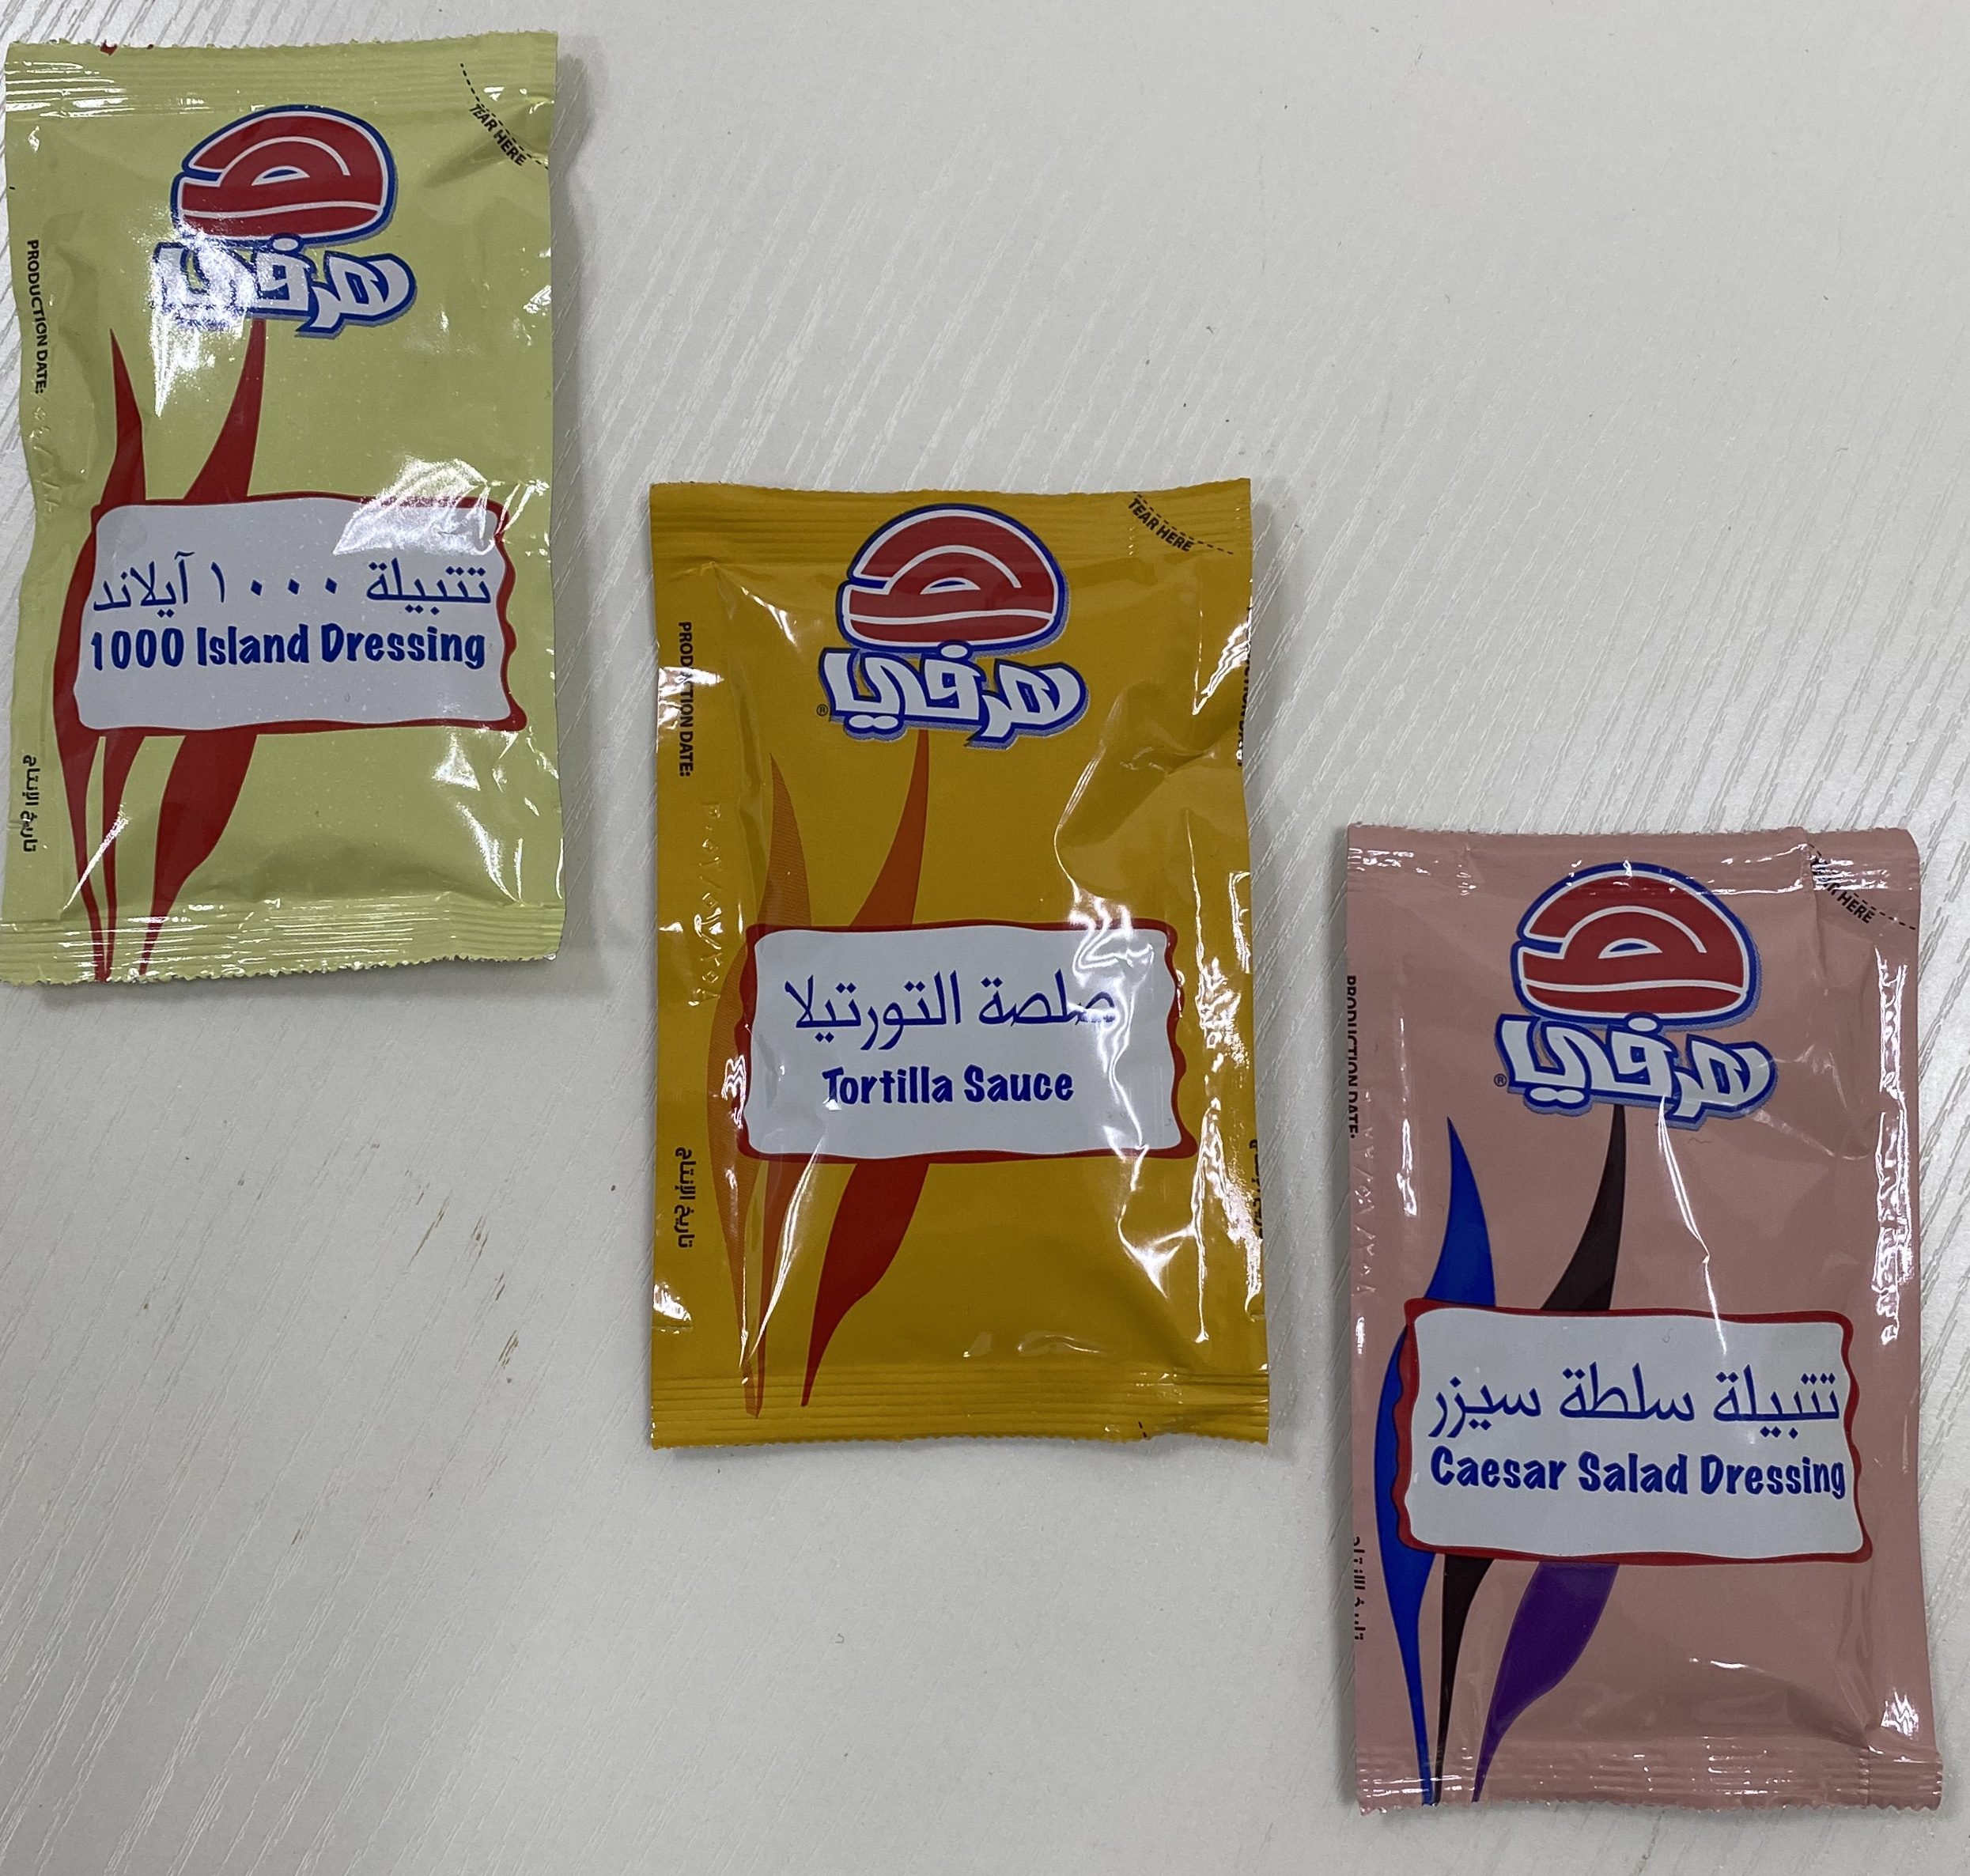
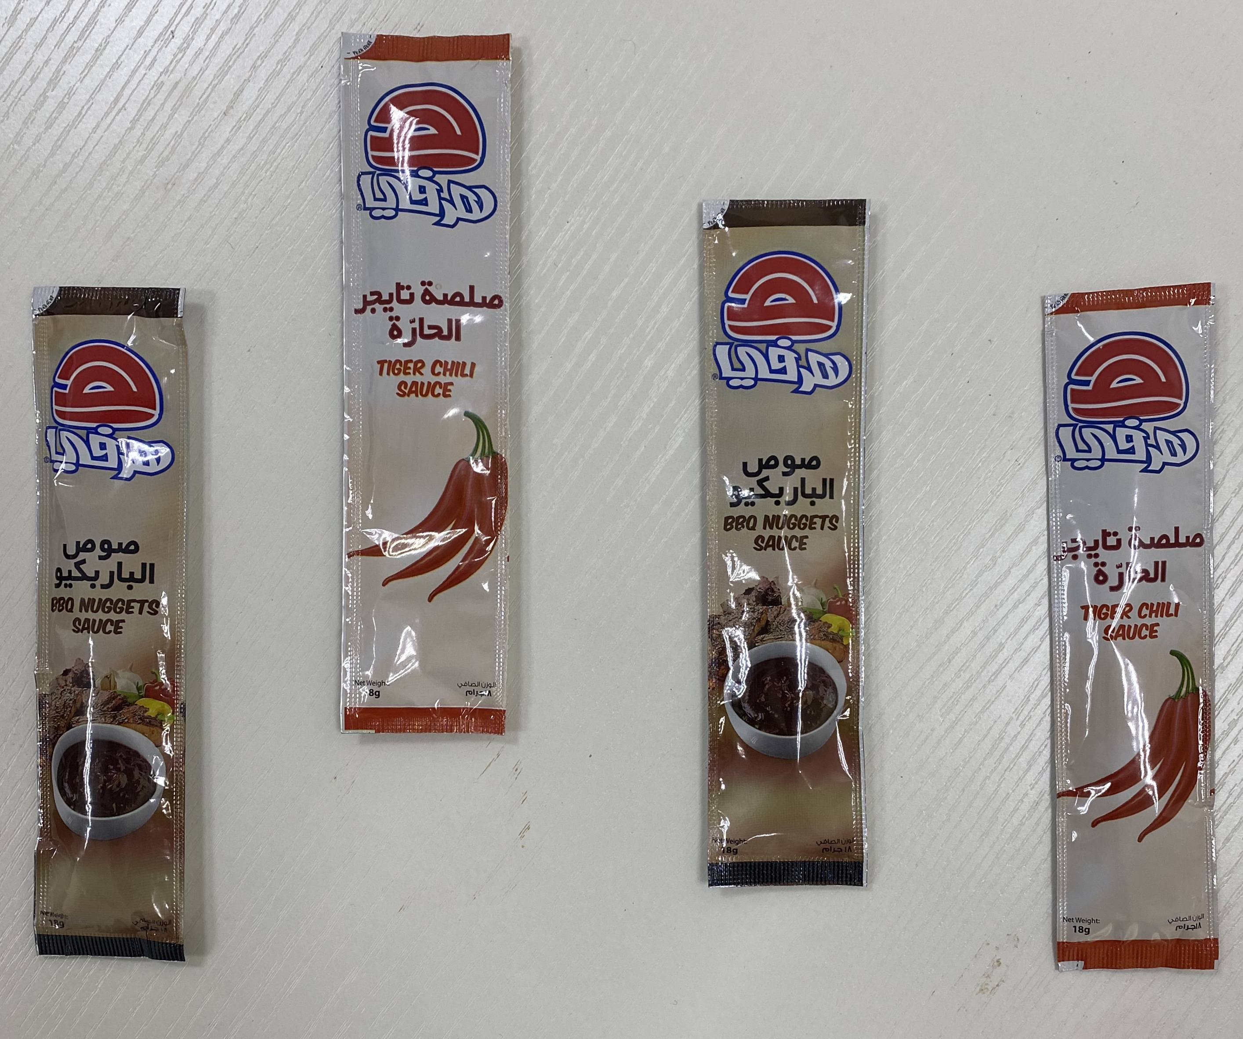
HERFY PRODUCTS

Slide 19
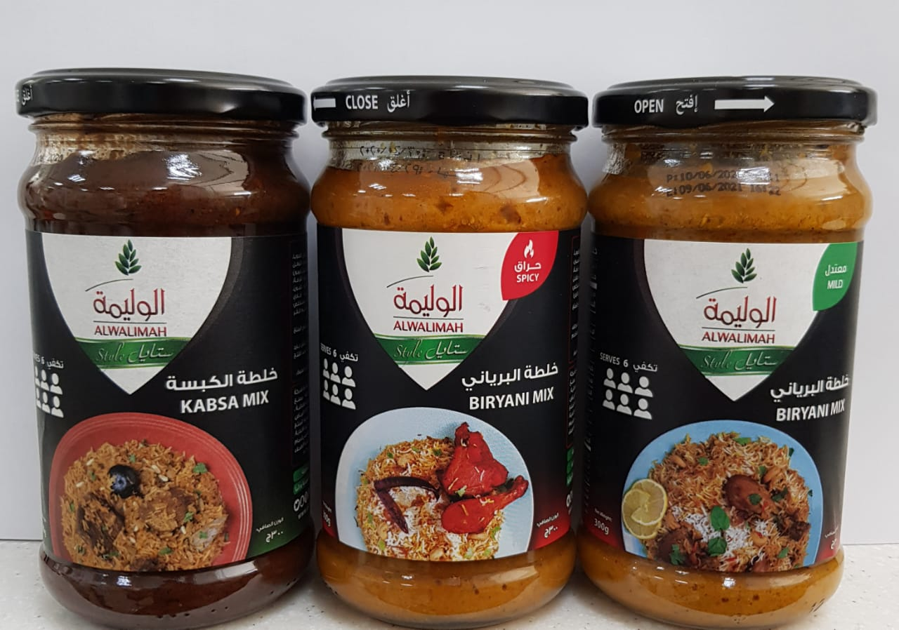
MAYAR PRODUCTS (AL WALIMAH)

Slide 20
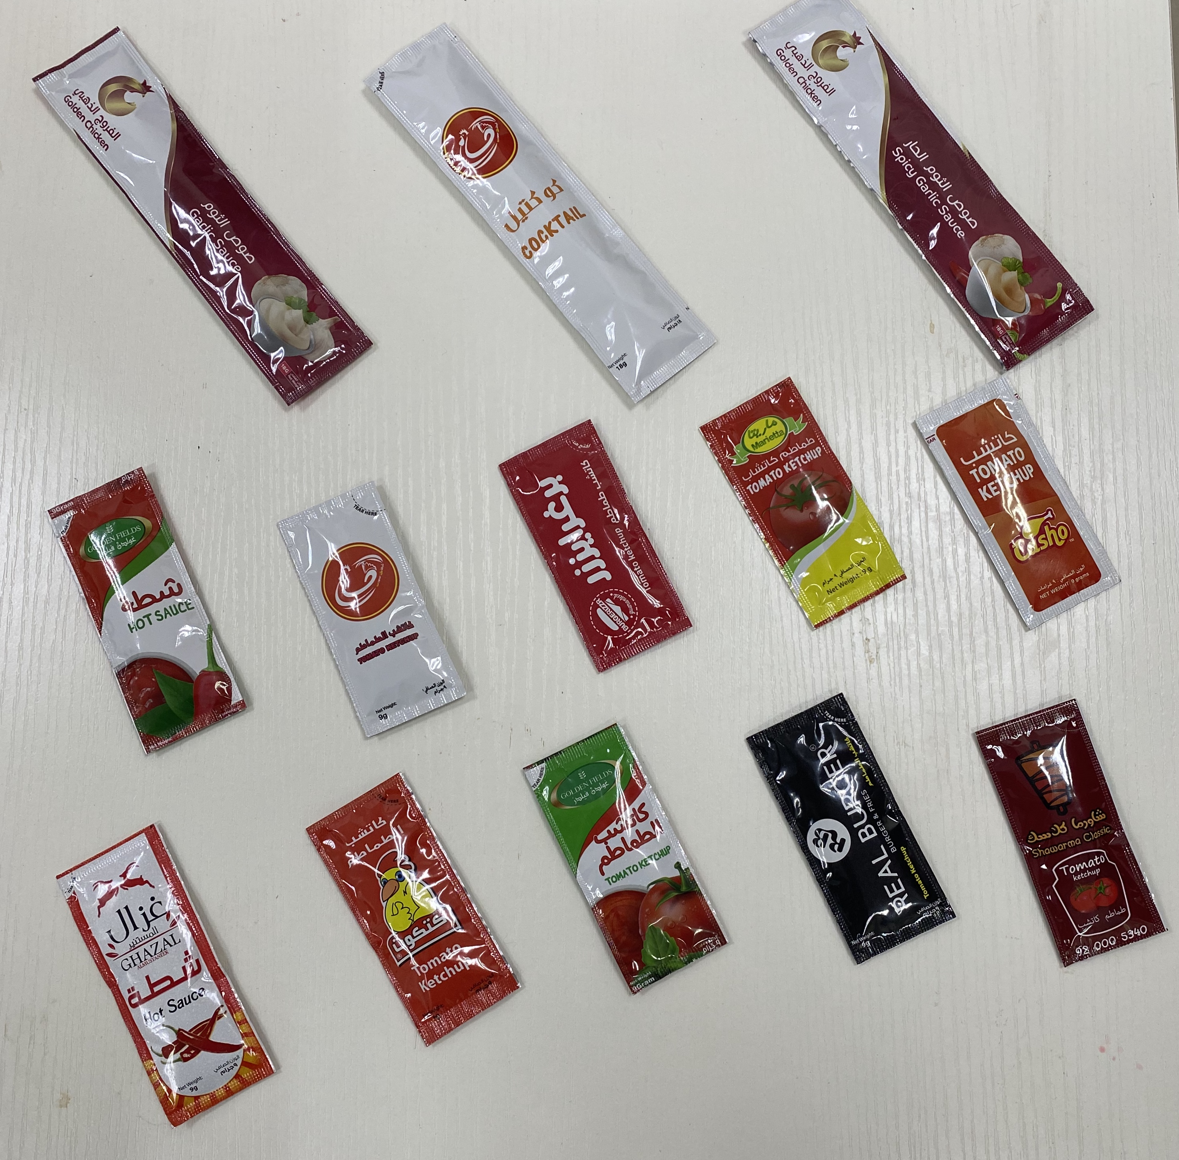
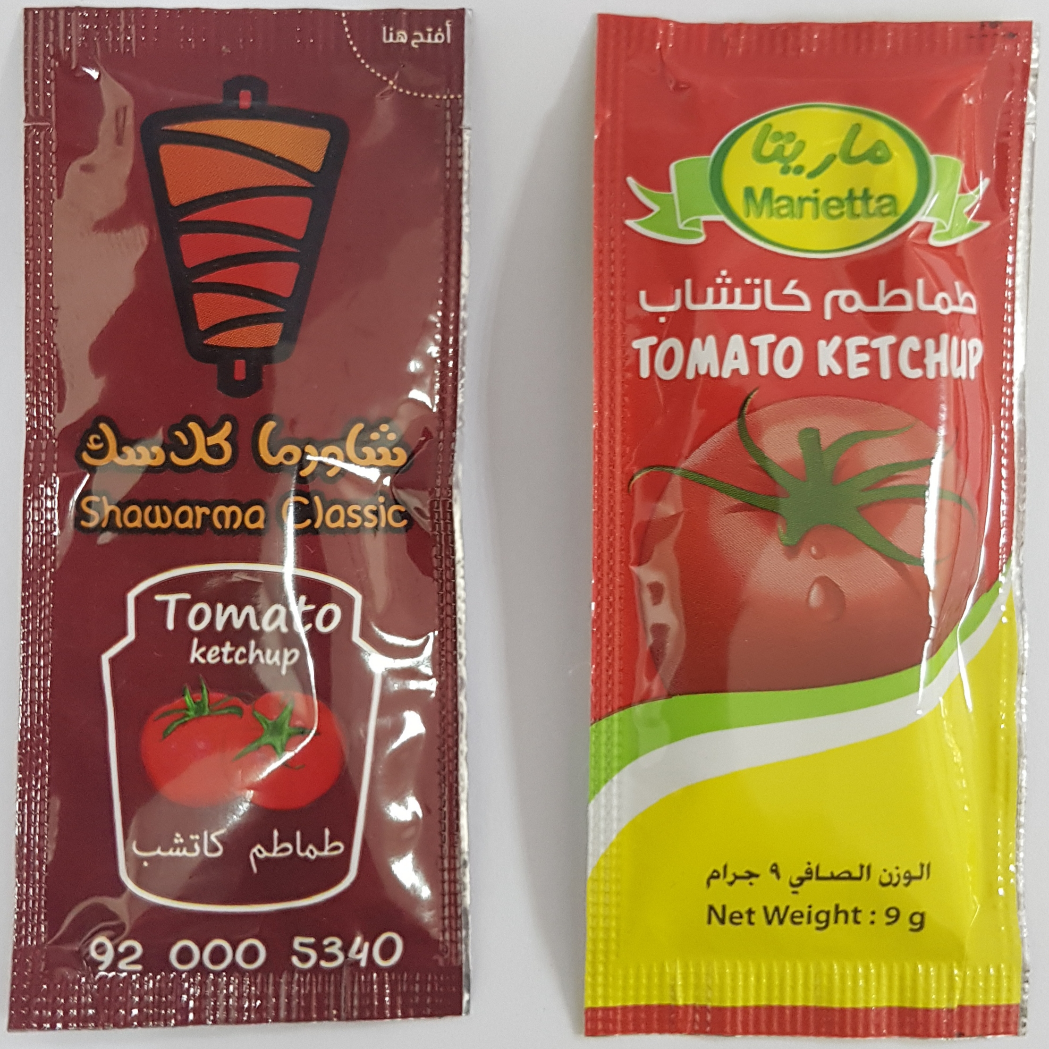
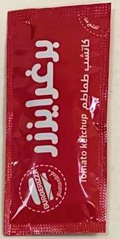
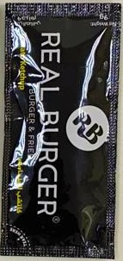
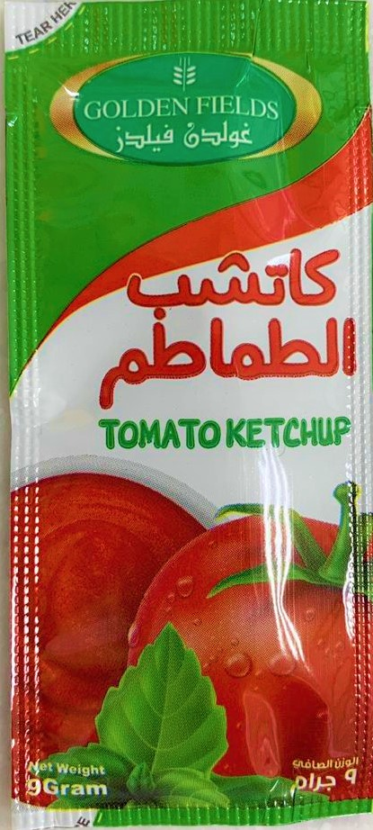
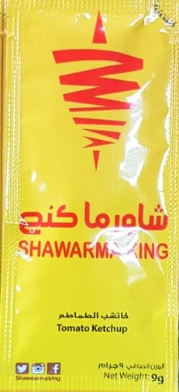

Slide 21
“Together we can achieve more” SHUKRAN ☺

